Slide 1
Topic: Total Surface area
Eq: How is calculating the tsa of an object useful in real life?
1

Slide 2
Lesson objective
By the end of this lesson you will be able to:
- Solve problems involving finding the TSA of real life objects
Notes:
Lesson

Slide 3
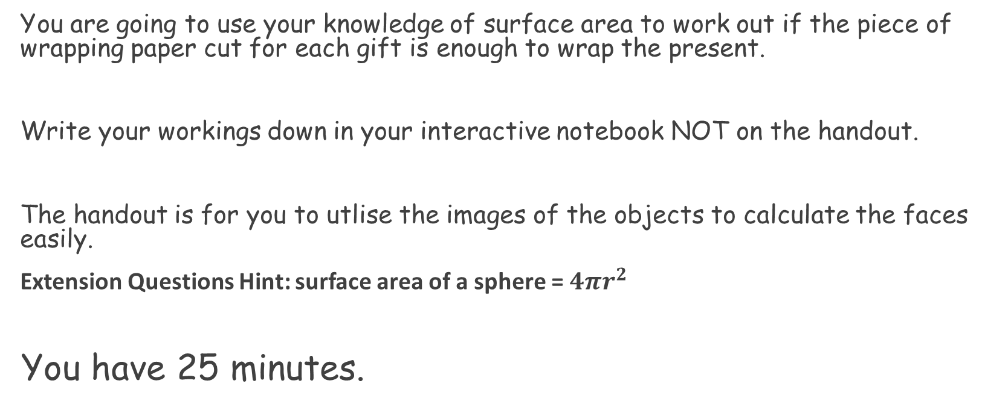
TASK
You are going to use your knowledge of surface area to work out if the piece of wrapping paper cut for each gift is enough to wrap the present.
Write your workings down in your interactive notebook NOT on the handout.
The handout is for you to utlise the images of the objects to calculate the faces easily.
Extension Questions Hint: surface area of a sphere = $4πr^{2}$
You have 25 minutes.

Slide 4
Answers
Haribo = 650cm² - fits
Trebor = 150.80cm² – does not fit
Chocolate Orange = 201.06cm² - does not fit
PS4 = 4392cm² – fits
Toblerone = 504cm² - fits
iPad = 2318cm² - does not fit
Football = 1520.53cm² - fits

Slide 5
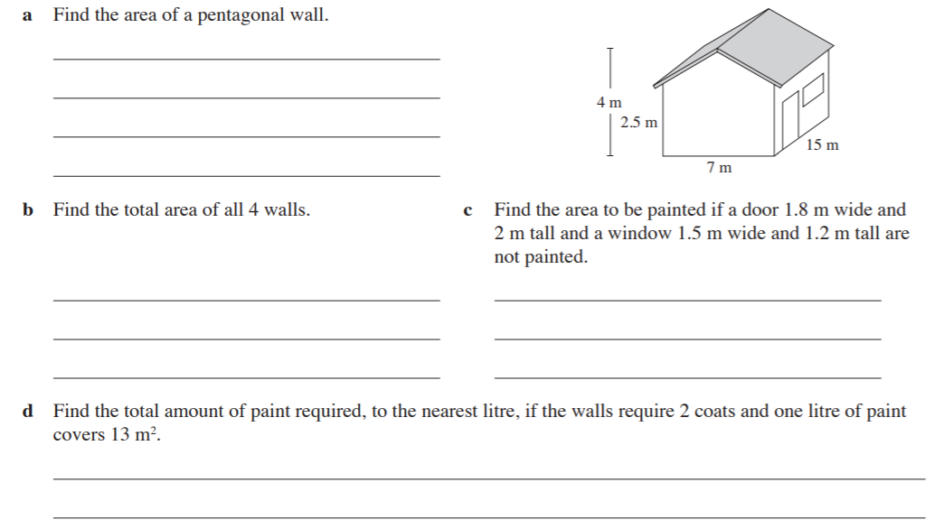
EXIT PASS

